Slide 1
Evidence for the Big Bang Theory
Have Your Cornell Notes Handy!

Slide 2
Learning Goal:
By the end of this lesson, you will be able to explain three pieces of evidence for the Big Bang Theory:
Cosmic Microwave Background Radiation
Redshift of galaxies
Elemental composition of our universe

Slide 3

Let’s Review… A Theory

Slide 4
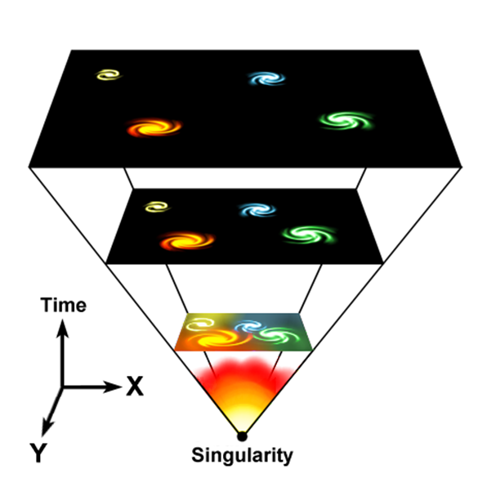
What is the Big Bang Theory?
George Lemaitre (a priest and physics professor) proposed the theory of the expanding universe.
13.82 billion years ago, violent expansion occurred from a single point, the size of an atom.
All matter and space were created; first quarks, electrons, protons, neutrons, atoms and larger elements.
For every million photons, 1 proton was made
*The “Big Bang” was a name (mockingly) given to Lemaitre’s idea – and it stuck ☺
Notes:
Image credit: Fredrik, https://commons.wikimedia.org/wiki/File:Universe_expansion.png (C0)

Slide 5
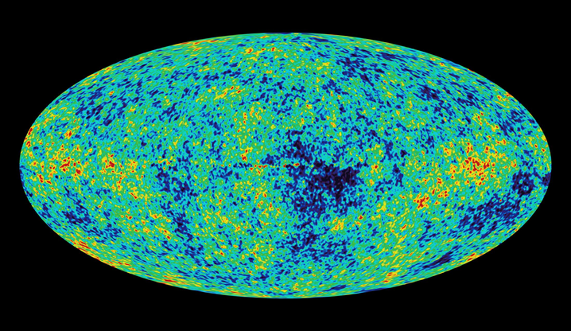
Cosmic Microwave Background Radiation (CMB)
CMB is the “after glow” or “leftovers” from the big bang that permeates (spreads) in all directions of the universe.
Physicists agreed that CMB was leftover ‘heat’ in the form of microwave radiation, which was still cooling from the Big Bang.
Original temperature of the universe: 3000 Kelvin
Today, universe is approximately 3 Kelvin
The amount of cooling says how far the light has travelled, which determined the age of the universe: 13.82 billion years.
Notes:
Image credit: NASA, https://commons.wikimedia.org/wiki/File:WMAP_image_of_the_CMB_anisotropy.jpg (C0)

Slide 6
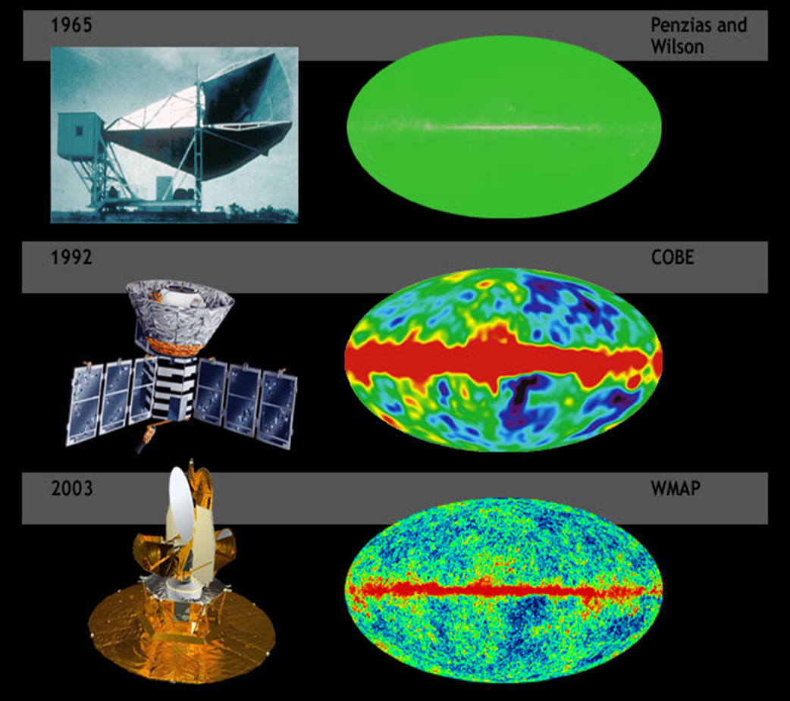
Cosmic Microwave Background Radiation
The first sound of microwave radiation was thought to be pigeon droppings! :) Their detection of this CMB was made from a Horn Antenna!
COBE (Cosmic Background Explorer) was launched in 1989- 500 miles from Earth. Detected the near perfect blackbody spectrum in 1992.
WMAP launched in 2001. In 2003, the WMAP satellite gave a better resolution of the small fluctuations of temperature
(WMAP = Wilkinson Microwave Anisotropy Probe)
Notes:
Image credit: NASA, https://commons.wikimedia.org/wiki/File:BigBangNoise.jpg (C0)

Slide 7
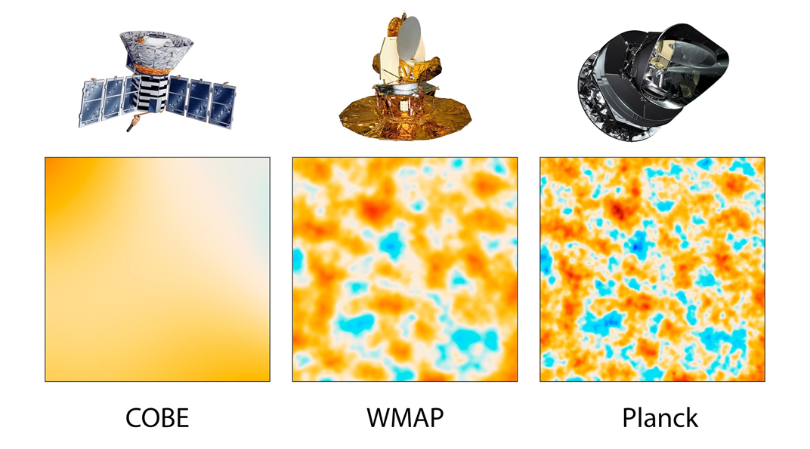
Cosmic Microwave Background Radiation, continued
Planck satellite was a space observatory operated by the European Space Agency (ESA) from 2009 to 2013, providing us with the most accurate and detailed readings of Cosmic Microwave Background Radiation.
Notes:
Image credit: NASA, https://commons.wikimedia.org/wiki/File:PIA16874-CobeWmapPlanckComparison-20130321.jpg (C0)

Slide 8
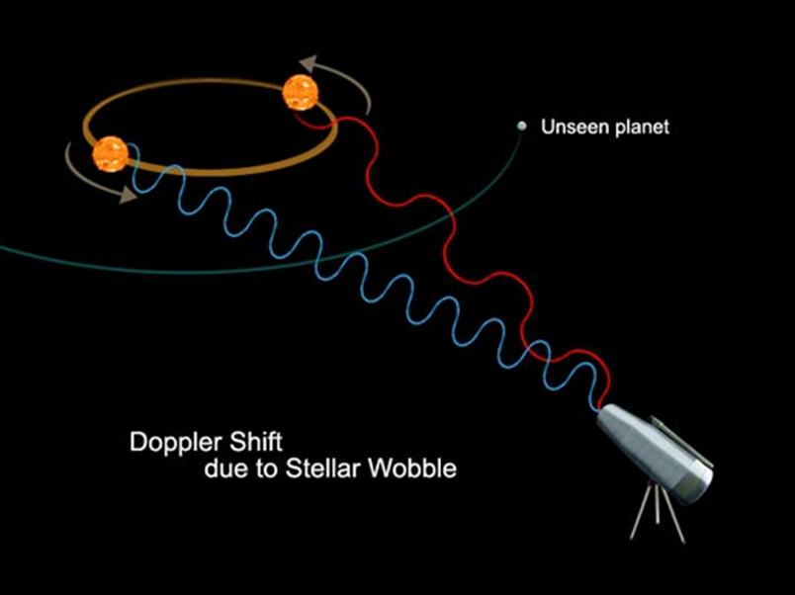
Redshift of Galaxies
The apparent wavelength lengthens as the galaxy moves away from the observer. The Velocity of galaxies can be calculated: v = H x d
The exact value of the Hubble constant is still somewhat uncertain, but is generally believed to be around 65 kilometers per second for every megaparsec in distance.
If most galaxies are moving away from each other, then the universe is expanding outwards from a central point.
Hubble’s Space Telescope (named after Edwin Hubble) was important in determining recessional velocity of galaxies.
*Remember, red color has a longer wavelength than blue – therefore, it is moving away!
Notes:
Image credit: NASA, https://commons.wikimedia.org/wiki/File:Doppler_shift_caused_by_exoplanet.jpeg (C0)

Slide 9
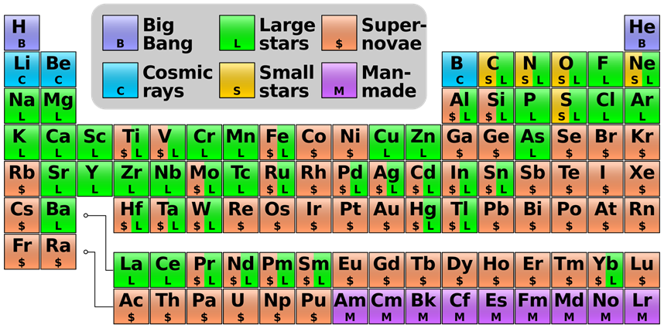
Mixture of Elements
The matter in the universe is about 75% hydrogen & 25% helium.
•The abundance of H & He supports a particular process of past atomic creation, where the larger elements formed from the smaller elements.
Notes:
Image credit: Cmglee, https://commons.wikimedia.org/wiki/File:Nucleosynthesis_periodic_table.svg (CC BY-SA 3.0)

Slide 10
Summary
The big bang theory states the universe began the size of an atom and violently exploded outwards, eventually cooling and creating larger atomic elements.
Hubble's galaxy redshift observations shows that most galaxies are moving away from each other.
The distribution of cosmic microwave background radiation extends in all directions of the universe, which verifies predictions of universe cooling from a titanic, rapid expansion.
The abundance of lighter elements in the Universe, which suggests that these first elements (hydrogen and helium) were formed at the Big Bang and are the precursors for all other elements.

